Slide 1
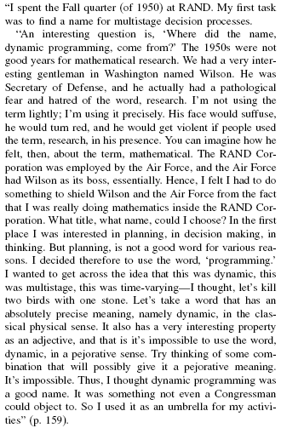
Where did “dynamic programming” come from?
Richard Bellman On the Birth of Dynamic Programming
Stuart Dreyfus
http://www.eng.tau.ac.il/~ami/cd/or50/1526-5463-2002-50-01-0048.pdf

Slide 2
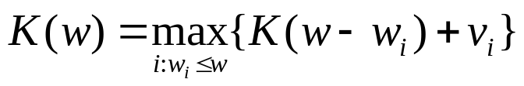
0-1 Knapsack problem
0-1 Knapsack – A thief robbing a store finds n items worth v₁, v₂, .., v_{n} dollars and weight
w₁, w₂, …, w_{n} pounds, where v_{i} and w_{i} are integers. The thief can carry at most W pounds in the knapsack. Which items should the thief take if he/she wants to maximize value?
Repetition is allowed, that is you can take multiple copies of any item

